Slide 1
Shop Performance: What is happening to the business?
Executive analysis | January 2024 – June 2026
The story in three lines
Revenue was broadly stable across 2024 and 2025, but the first six months of 2026 are materially lower.
Electronics is the main revenue engine, while a small group of products carries a large share of sales.
8.0% of order records were cancelled or returned and 3.85% of payment attempts failed — areas for operational attention.
BrightLearn Shop Performance Case Study | 1

Slide 2
1. Data quality — what we found before analysing
Customers
10,000
one row per customer
Orders supplied
50,120
120 duplicate order IDs
Products
20
complete product list
Payment attempts
50,000
one per order after dedupe
Date range
Jan 2024–Jun 2026
matches case study
Cleaning decisions used
Removed duplicate OrderID records, keeping one record per order.
Standardised city names (for example, Mashad → Mashhad; Tehran/tehran).
Calculated revenue as Quantity × UnitPrice × (1 − Discount).
Counted business revenue only where the order was Completed and the payment was Paid.
Excluded rows with missing order dates and non-positive quantities from performance totals.
Issues to disclose
35 orders have missing dates; 80 have missing quantity; 221 have missing discount; 452 have missing payment method.
30 orders reference a customer not found in the customer table.
19 completed-and-paid records contain negative quantities; these were treated as data-quality exceptions.
Because 2026 ends in June, comparisons with full-year 2024/2025 would be misleading; H1 comparisons are used.
BrightLearn Shop Performance Case Study | 2

Slide 3
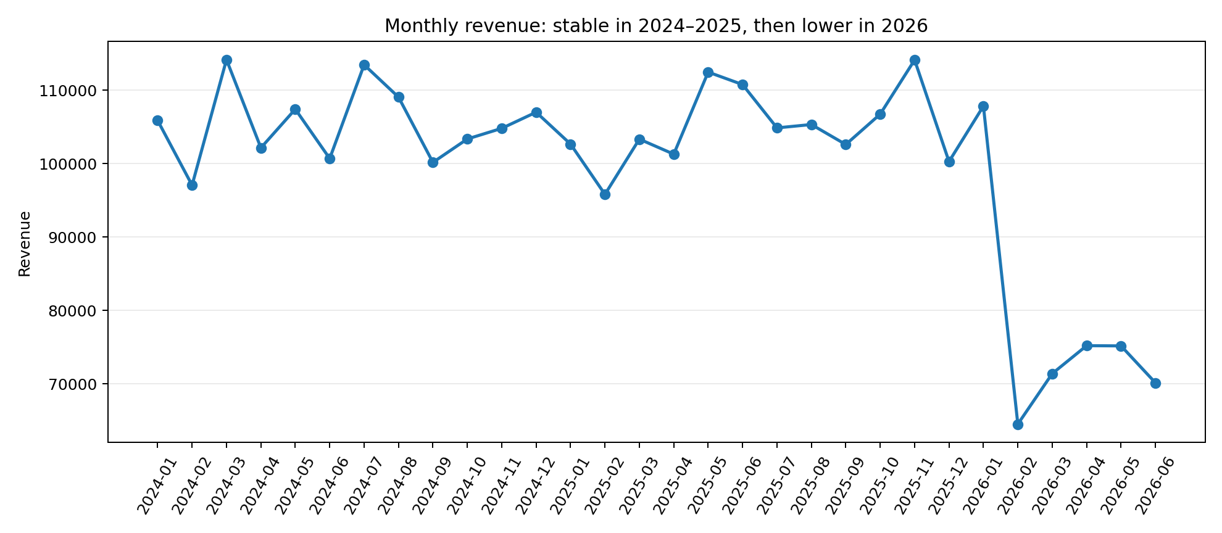
2. Overall performance — the key issue is the 2026 slowdown
Valid revenue
R2.99m
Completed + Paid
Valid orders
42,721
after quality exclusions
Average order
R69.99
revenue per valid order
Units sold
80,442
positive quantities
H1 2026
R464k
-25.9% vs H1 2025
So what?
H1 2024 revenue: R627.4k.
H1 2025 revenue: R626.4k — essentially flat.
H1 2026 revenue: R464.3k — 25.9% below H1 2025.
Average order value did not collapse, so the decline is more consistent with fewer sales/orders than much smaller baskets.
BrightLearn Shop Performance Case Study | 3

Slide 4
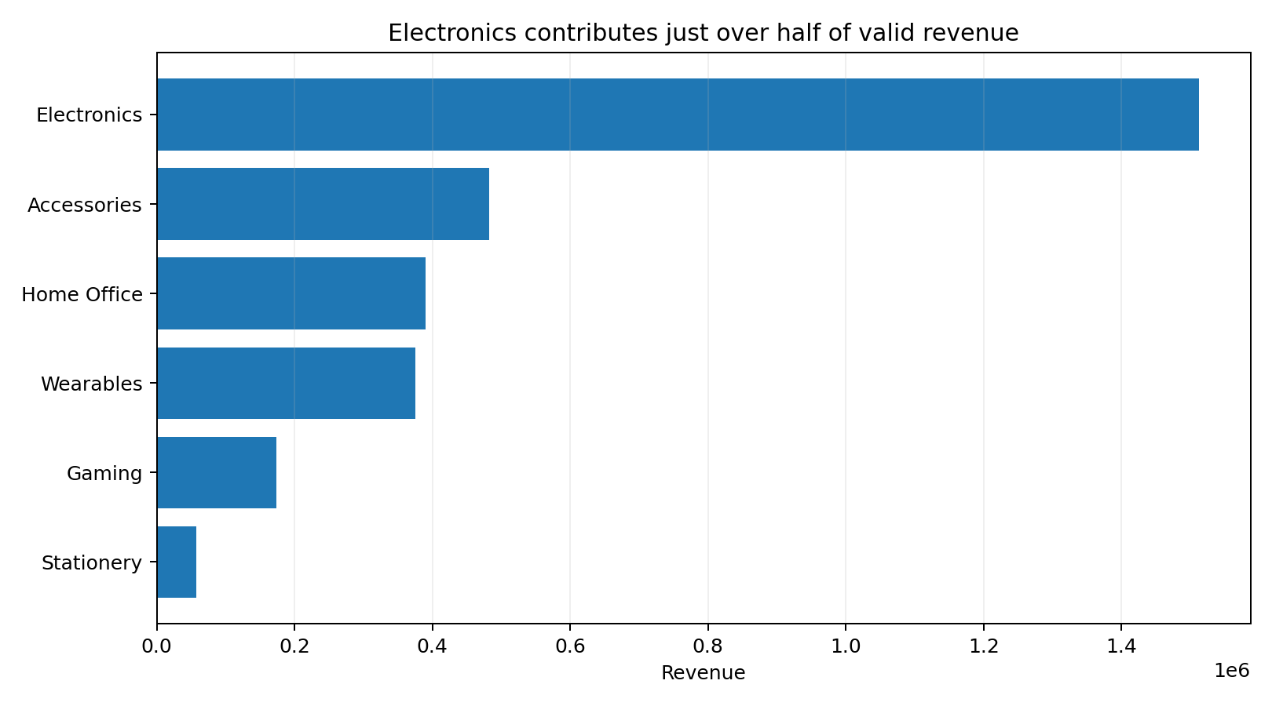
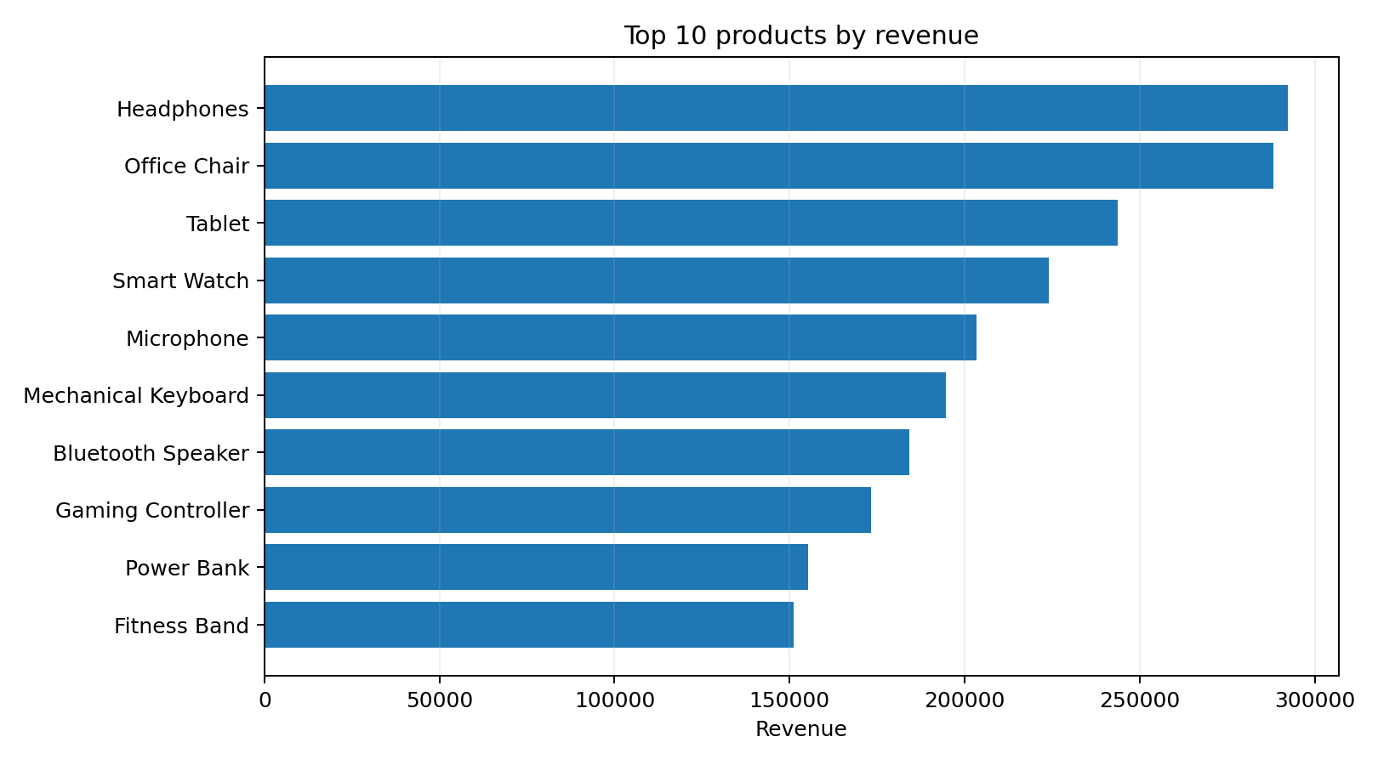
3. What is selling? Revenue is concentrated in Electronics
Business meaning
Electronics generated R1.51m, or 50.6% of valid revenue. Headphones (R292k) and Office Chair (R288k) were the two largest individual products by revenue.
BrightLearn Shop Performance Case Study | 4

Slide 5
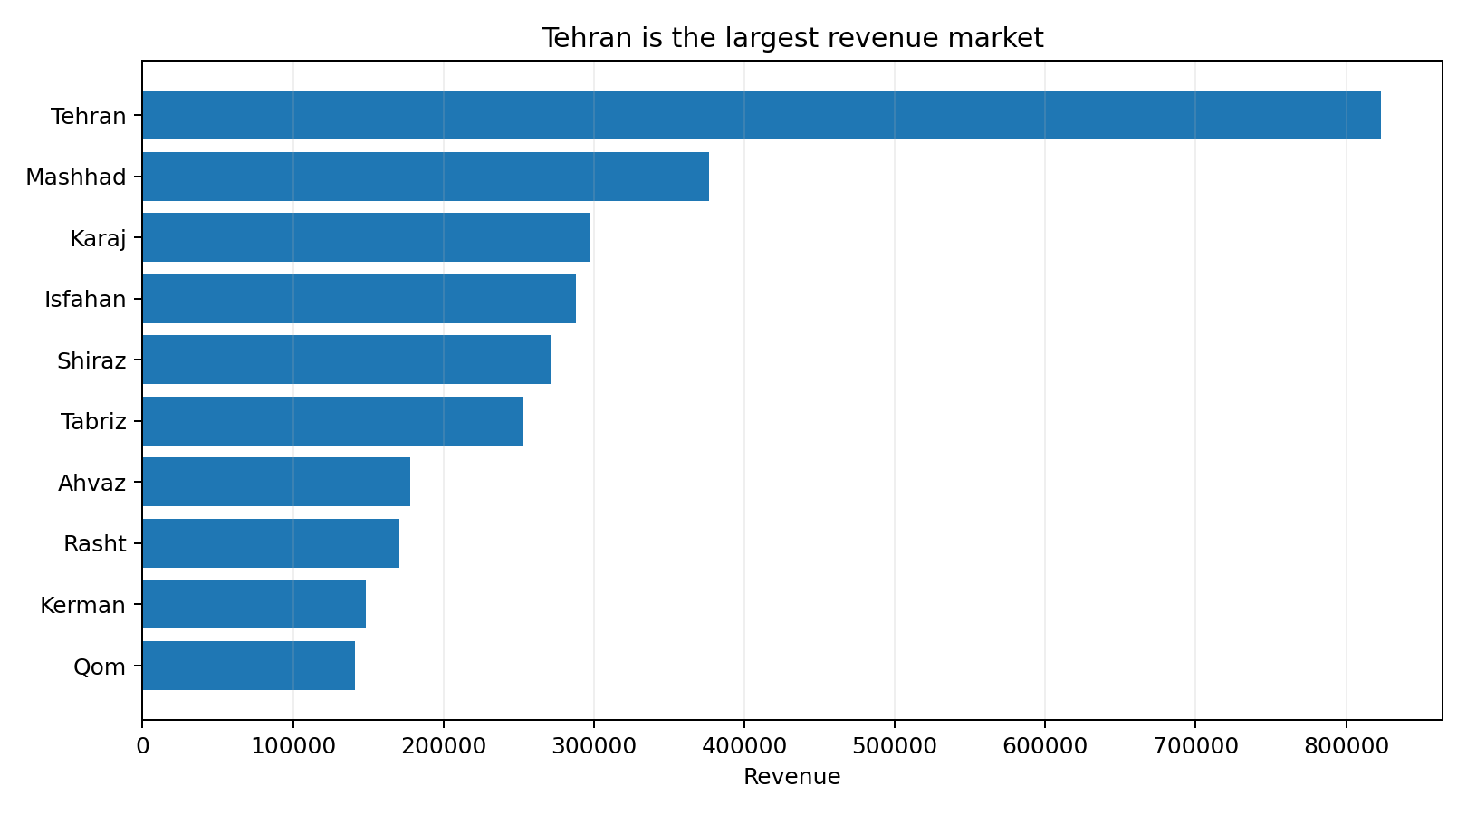
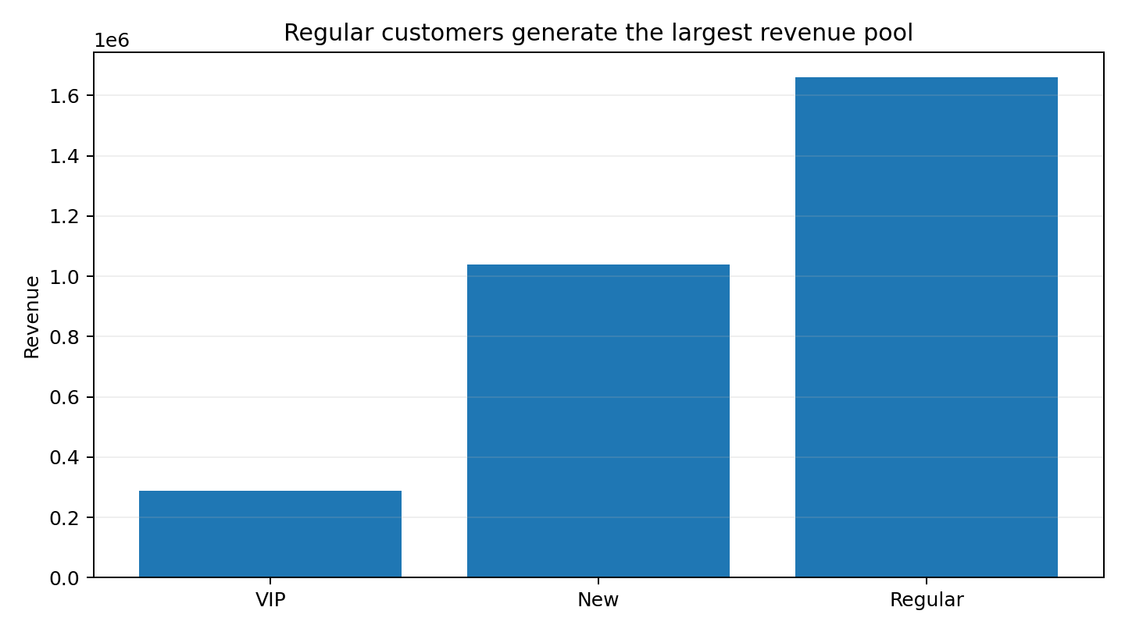
4. Where is the value? Tehran leads; Regular customers drive the revenue pool
Business meaning
Tehran contributes R822.9k (27.5%) of valid revenue. Regular customers contribute R1.66m (55.5%), while VIP customers contribute R288.5k (9.7%).
BrightLearn Shop Performance Case Study | 5

Slide 6
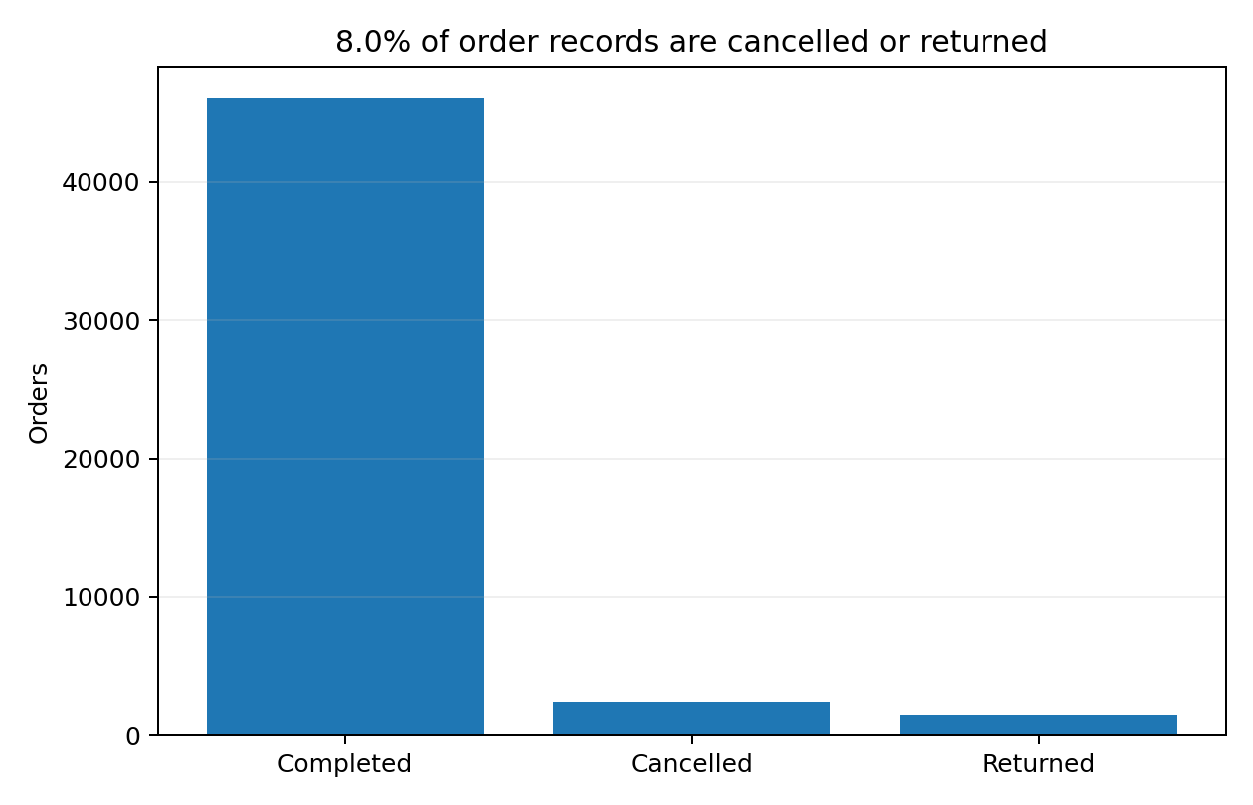
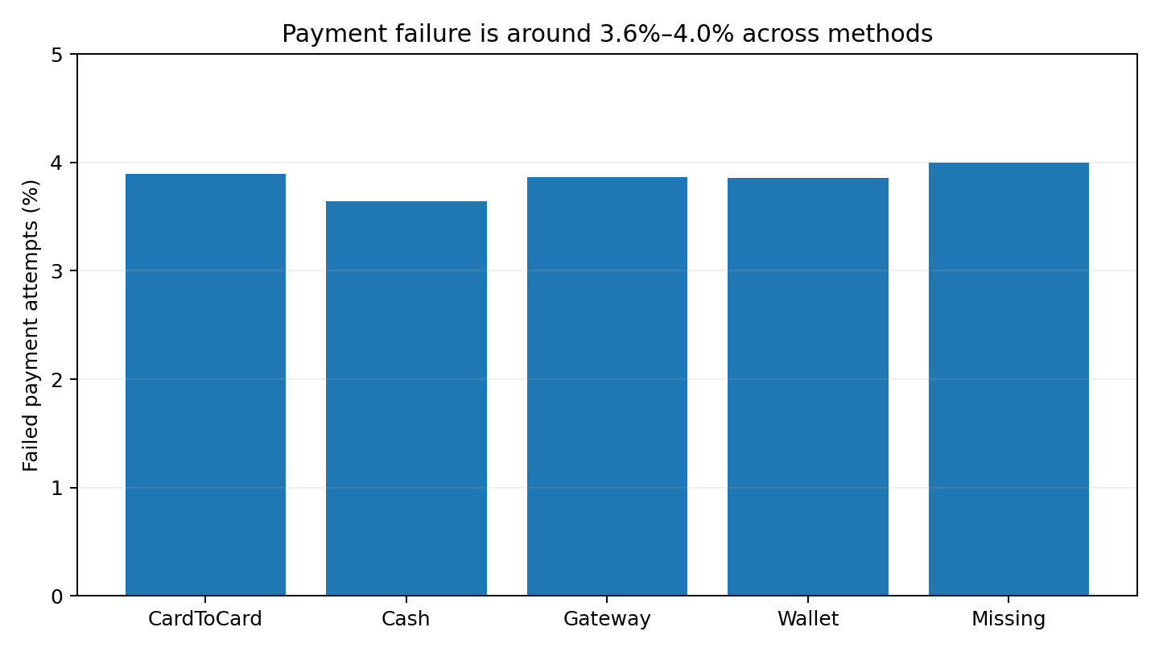
5. Where is revenue leaking? Cancellations, returns and failed payments
So what?
4.94% of order records were cancelled and 3.06% returned — 8.0% combined. Payment failures were 3.85% overall, with little variation by payment method.
BrightLearn Shop Performance Case Study | 6

Slide 7
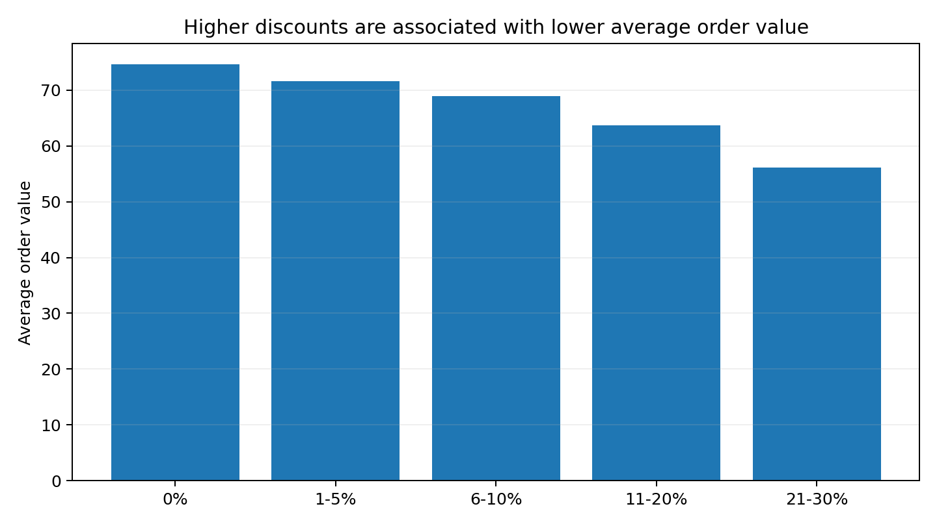
6. Discounts — more discount does not mean a bigger basket
What the data says
Orders with no discount averaged R74.59.
Orders with 11–20% discount averaged R63.63.
Orders with 21–30% discount averaged R56.13.
Revenue per unit also fell as discount levels increased.
The relationship is descriptive, not proof that discounts caused lower order values; product mix and customer behaviour may also matter.
BrightLearn Shop Performance Case Study | 7

Slide 8
7. Three actions for the Head of Operations
1 | Recover the 2026 order gap
Track weekly orders by city, category and customer segment.
Investigate why H1 2026 has fewer valid orders than H1 2025.
Start with Tehran and Electronics because they represent the largest revenue pools.
2 | Reduce avoidable leakage
Review the cancellation and return reasons behind the 8.0% rate.
Monitor failed payments by method and customer journey stage.
Set a simple monthly target for lower cancellations, returns and payment failures.
3 | Make discounts earn their keep
Do not judge a promotion by order volume alone.
Measure revenue, average order value and revenue per unit by discount band.
Prioritise targeted offers around strong products instead of broad high discounts.
BrightLearn Shop Performance Case Study | 8

